Slide 1
Income from House Property

Slide 3
Learning outcomes
The chapter will provide information to students about :
what are the various house properties whose income can be charge under the head of Income from House property.
The types of house properties whose income is exempt from tax under this head.
How to calculated income under this head and
Various exemption available from the income from house property

Slide 4
Meaning of income from house property
Income from houses ,building , bungalow, godowns etc is to be computed and assessed to tax under head Income from House Property.
House Property Income = Annual value of building-Deductions u/s 24

Slide 5
Conditions to be considered before charging any income as income from house property
The assessee is the owner of that property.
The property must consist of house, buildings and/or land appurtenant.
3. The property may be used for any purpose except used by the owner for the purpose of running his business or profession.
Disputed ownership
Foreign house property
Notes:
Don’t ignore paying tax on rental income from foreign property
Business Standard
04 August 2017
Even if you have kept the house for your own use and not let it out, estimate the deemed rental income from it and pay tax on it.
Many high net worth individuals who own houses abroad have in recent times been questioned by income tax officials for not having paid tax on the “deemed rental income” from those properties. It, therefore, becomes important for owners of foreign properties to understand the concept of deemed rental income and their tax liability on it.
For tax purposes, one house (in India or abroad) is treated as self-occupied. The owner has to pay tax on rental income on the other house (or houses). If the other house is not rented out, he has to arrive at a deemed or notional rental income and pay tax on it. “A person resident in India is liable to pay tax in India on his global income. Hence, rental income from house property — let out or on deemed basis — situated abroad is taxable in India. The income tax law does not make any distinction between house properties situated in India or abroad for computing income from house property,” says Suresh Surana, founder, RSM Astute Consulting Group.
In case of the taxpayers owning more than one house (all used for own purpose) and where one or more of them is situated outside India, they will have to do some calculation and arrive at the taxable value of each property by considering it first as selfoccupied and then as let out (see table). "The taxpayer can then choose a combination which results in the lowest taxable income from house property," says Chetan Chandak, head of tax research, H&R Block India.
To calculate the deemed rental, the person needs to use the standard rent or let-able value of the property. "Obtain quotes from property brokers in the area or browse on websites that provide rental rates for that overseas location. Estate tax bills can also provide some indication in this regard," says Nidhi Seksaria, partner and leader–real estate and construction, BDO India.
The rent you receive or the deemed rent is the gross annual value, from which you can reduce the municipal taxes paid during the year to arrive at the net asset value (NAV). From this, you can avail of two deductions under Section 24 of the I-T Act. One is the standard deduction under Section 24(A), wherein you can deduct 30 per cent of the NAV. Next, under Section 24 (B) you can deduct the interest paid on home loan. You will then arrive at the income from house property, which is added to your other sources of income and taxed according to the slab rate applicable to you. "You also need to check your eligibility for availing foreign tax credit related to taxes paid abroad on a house situated abroad under the relevant tax treaty provisions. If available, this will reduce your net tax outgo in India," says Seksaria.
In countries such as the US, the property is usually managed by a real estate management agency, which charges a commission and a property management charge. This is over and above the property tax, mortgage amount, etc. paid by it on behalf of the client. The property management fee is assumed to be included in the standard deduction (30 per cent of NAV) which one gets under Indian tax laws. But there are differing views regarding the deductibility of the commission charged as percentage of rent collected from the tenant. "Some consider it as deductible from the amount of gross rent as it is in the nature of diversion of income. Others opine that this should be part of the 30 per cent standard deduction and no separate deduction is admissible for it. This needs to be evaluated in the light of the facts of each case based on the terms of agreement with the agency," says Chandak.

Slide 6
Conditions to be considered before charging any income as income from house property
When income not treated as House property income
a) smooth running of business
b) Subletting
c) Composite Letting
d)Income from hotel business/ paying guest accommodation

Slide 7
Exempted income from house property
Agricultural house property Section 2(1)(c)
House property Held for charitable purposes [Section 11]
Self occupied but vacant house [Section 23 (3)
House used for own business or profession
Property held by registered trade unions [ section 10(24)]
Property income of a local authority.
Property income of an approved Scientific Research Association.
Property income from Educational Institution and Hospital
One palace owned by former ruler of India
Property income of a political party
.

Slide 8
Different Types of Rental values
Actual Rent
Real Rental Value
Municipal Rental Value
Fair Rental Value
Standard Rent
Expected Rental Value

Slide 9
Calculation of Gross Annual value
Expected Rental Value : If rent Control Act is not applicable
MRV or
FRV or
Actual Rent received whichever is higher.
If Rent Control Act is applicable ,
a) Higher of MRV or FRV
b) Compare higher value of (a) with Standard Rent and lower of
these is ERV
c) Compare ERV with Actual Rent received.
d) Higher of these two is Annual Rental Value

Slide 10
Calculation of Gross Annual value
Expected Rental Value : If Rent Control Act is not applicable
MRV or
FRV or
Actual Rent received whichever is higher.
If Rent Control Act is applicable ,
MRV or
FRV Higher or Lower = ERV or higher =
Standard Rent Actual Rent Annual Rental
Value
Annual Rental Value = Gross Annual Value

Slide 11
Calculation of Gross Annual value
Rental Value | Case A Rs. | Case B Rs. | Case C Rs.
MRV | 60,000 | 60,000 | 60,000
FRV | 72,000 | 72,000 | 72,000
Standard Rent | NA | 66,000 | 70,000
Actual Rent | 75000 | 65000 | 68000
75000
66000
70000

Slide 12
Determination of annual value
A. Annual Value of Let out House Property
1. House property is let out for full year and there is no vacancy or unrealised rent ;
-Compare FRV and MRV
-Compare higher of these with Standard Rent and
lower is ERV
-Compare ERV with Actual rent received or
receivable and higher of these is ARV

Slide 13
Determination of annual value
House property is let out and there is vacancy.
If the house property was vacant for the full year the ARV is NIL.
House property is let out and there is vacancy.
If rent actually received or receivable is more than ERV,
Such rent received or receivable is ARV
Reduce the ARV so calculated for loss due to vacancy
(b) If rent actually received or receivable is less than ERV.
ERV shall be treated as ARV
Reduce the ARV so calculated for loss due to vacancy
Illus. 6

Slide 14
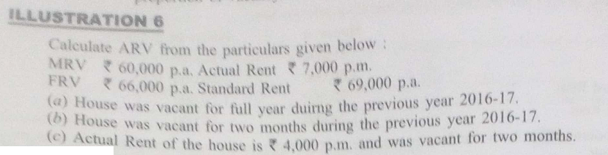

Slide 15
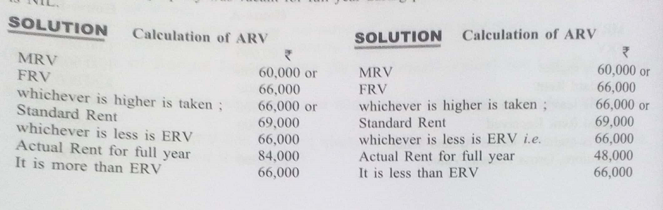
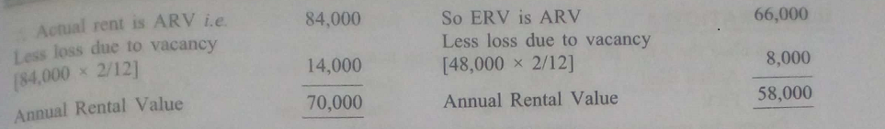

Slide 16
Determination of annual value
3. House property is let out and there is unrealised rent
(a) If rent actually received or receivable (after deducting unrealised rent as per conditions given) is more than ERV, such rent received or receivable is ARV.
(b) If rent actually received or receivable (after deducting unrealised rent as per conditions given) is less than ERV, such ERV is ARV .
Illus. 7,8

Slide 17
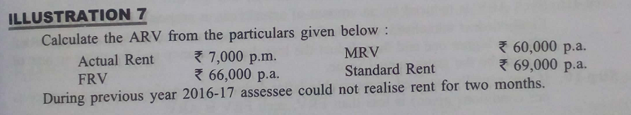

Slide 18
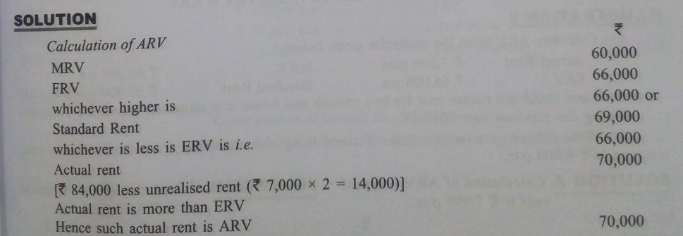

Slide 19
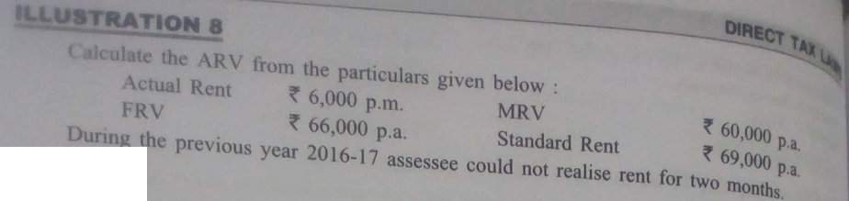

Slide 20
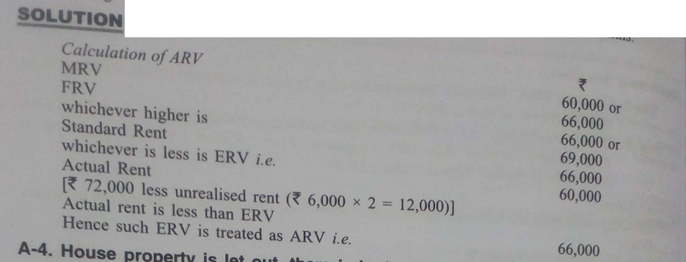

Slide 21
Determination of annual value
4. House Property is let out, there is vacancy also and there is unrealised rent.
House property is let out and there is unrealised rent
(a) If rent actually received or receivable (after deducting unrealised rent as per conditions given) is more than ERV, such rent received or receivable is ARV.
Reduce the ARV so calculated for loss due to vacancy .
(b) If rent actually received or receivable (after deducting unrealised rent as per conditions given) is less than ERV, such ERV is ARV .
Reduce the ARV so calculated for loss due to vacancy
Illus. 9

Slide 22
Determination of annual value
5. House Property is let out for a part of the year because it is either purchased or constructed during the previous year.
Take all rental valuesonly for that period for which house property is in existence. Compare them and select ARV accordingly.
Illus. 10

Slide 23
Income from let-out property
Gross annual value XXX
Less: Municipal taxes paid by owner XXX
Net annual value XXX
Less: Deduction U/s 24
Standard Deduction u/s 24(a)
-30% of Net Annual value XXX
Interest on borrowed capital u/s 24(b) XXX
Income from house property XXX

Slide 24
Annual rental Value incase of self occupied house property
In case of one self occupied house property ARV NIL
More than one house under own occupation :
ARV of one house is NIL and other deemed to be let out.
House property consists of various units and one unit is under own occupation and others are let out: In this case ARV of one unit is taken as NIL and other units are treated as let out.
If house property is partly let out and partly self occupied , it shall be treated as let out .
If the house property is let out for part of the year and under own occupation for part of the year, in this case also no benefit of self occupancy shall be allowed. It shall be treated as let out. But the rent is taken only for number of months house property is actually let out.

Slide 25
Deductions Under House Property
Standard Deduction – Standard Deduction is 30% of the Net Annual Value calculated above.
b.Deduction of Interest on Home Loan for the property –
In case of let out or deemed to be let house property : If you have rented out the property, the entire interest on the home loan is allowed as a deduction.
In case of self occupied house: Homeowners can claim a deduction of up to Rs.2 lakhs on their home loan .

Slide 26
Deductions Under House Property
The deduction on interest is limited to Rs.30,000 if following conditions are not satisfied:
i. The home loan must be for purchase and construction of a property;
ii. The loan must be taken on or after 1 April 1999;
iii. The purchase or construction or repair must be completed within 5 years from the end of the financial year in which the loan was taken

Slide 27
MCQs
1.Standard deduction in case of house property u/s 24 is :
1/5th of annual value b) 30% of Gross annual Value c) 30% of Annual value d) 30% of rent received
2. Annual value of vacant house property referred to in sec. 23(2)(b) is
a) MRV b) FRV c)Standard Rent d) NIL

Slide 28
3.Which property is not charged to tax :
Farm house b) palace of an ex-ruler
Business building d) All of the above
4. Income from house property for self business is:
a) MRV b) FRV c) Ne profit d) NIL

